Slide 1
Climate change adaptation whirlwind
An interactive introduction to past & current climate trends, future projections and climate change adaptation

Slide 2
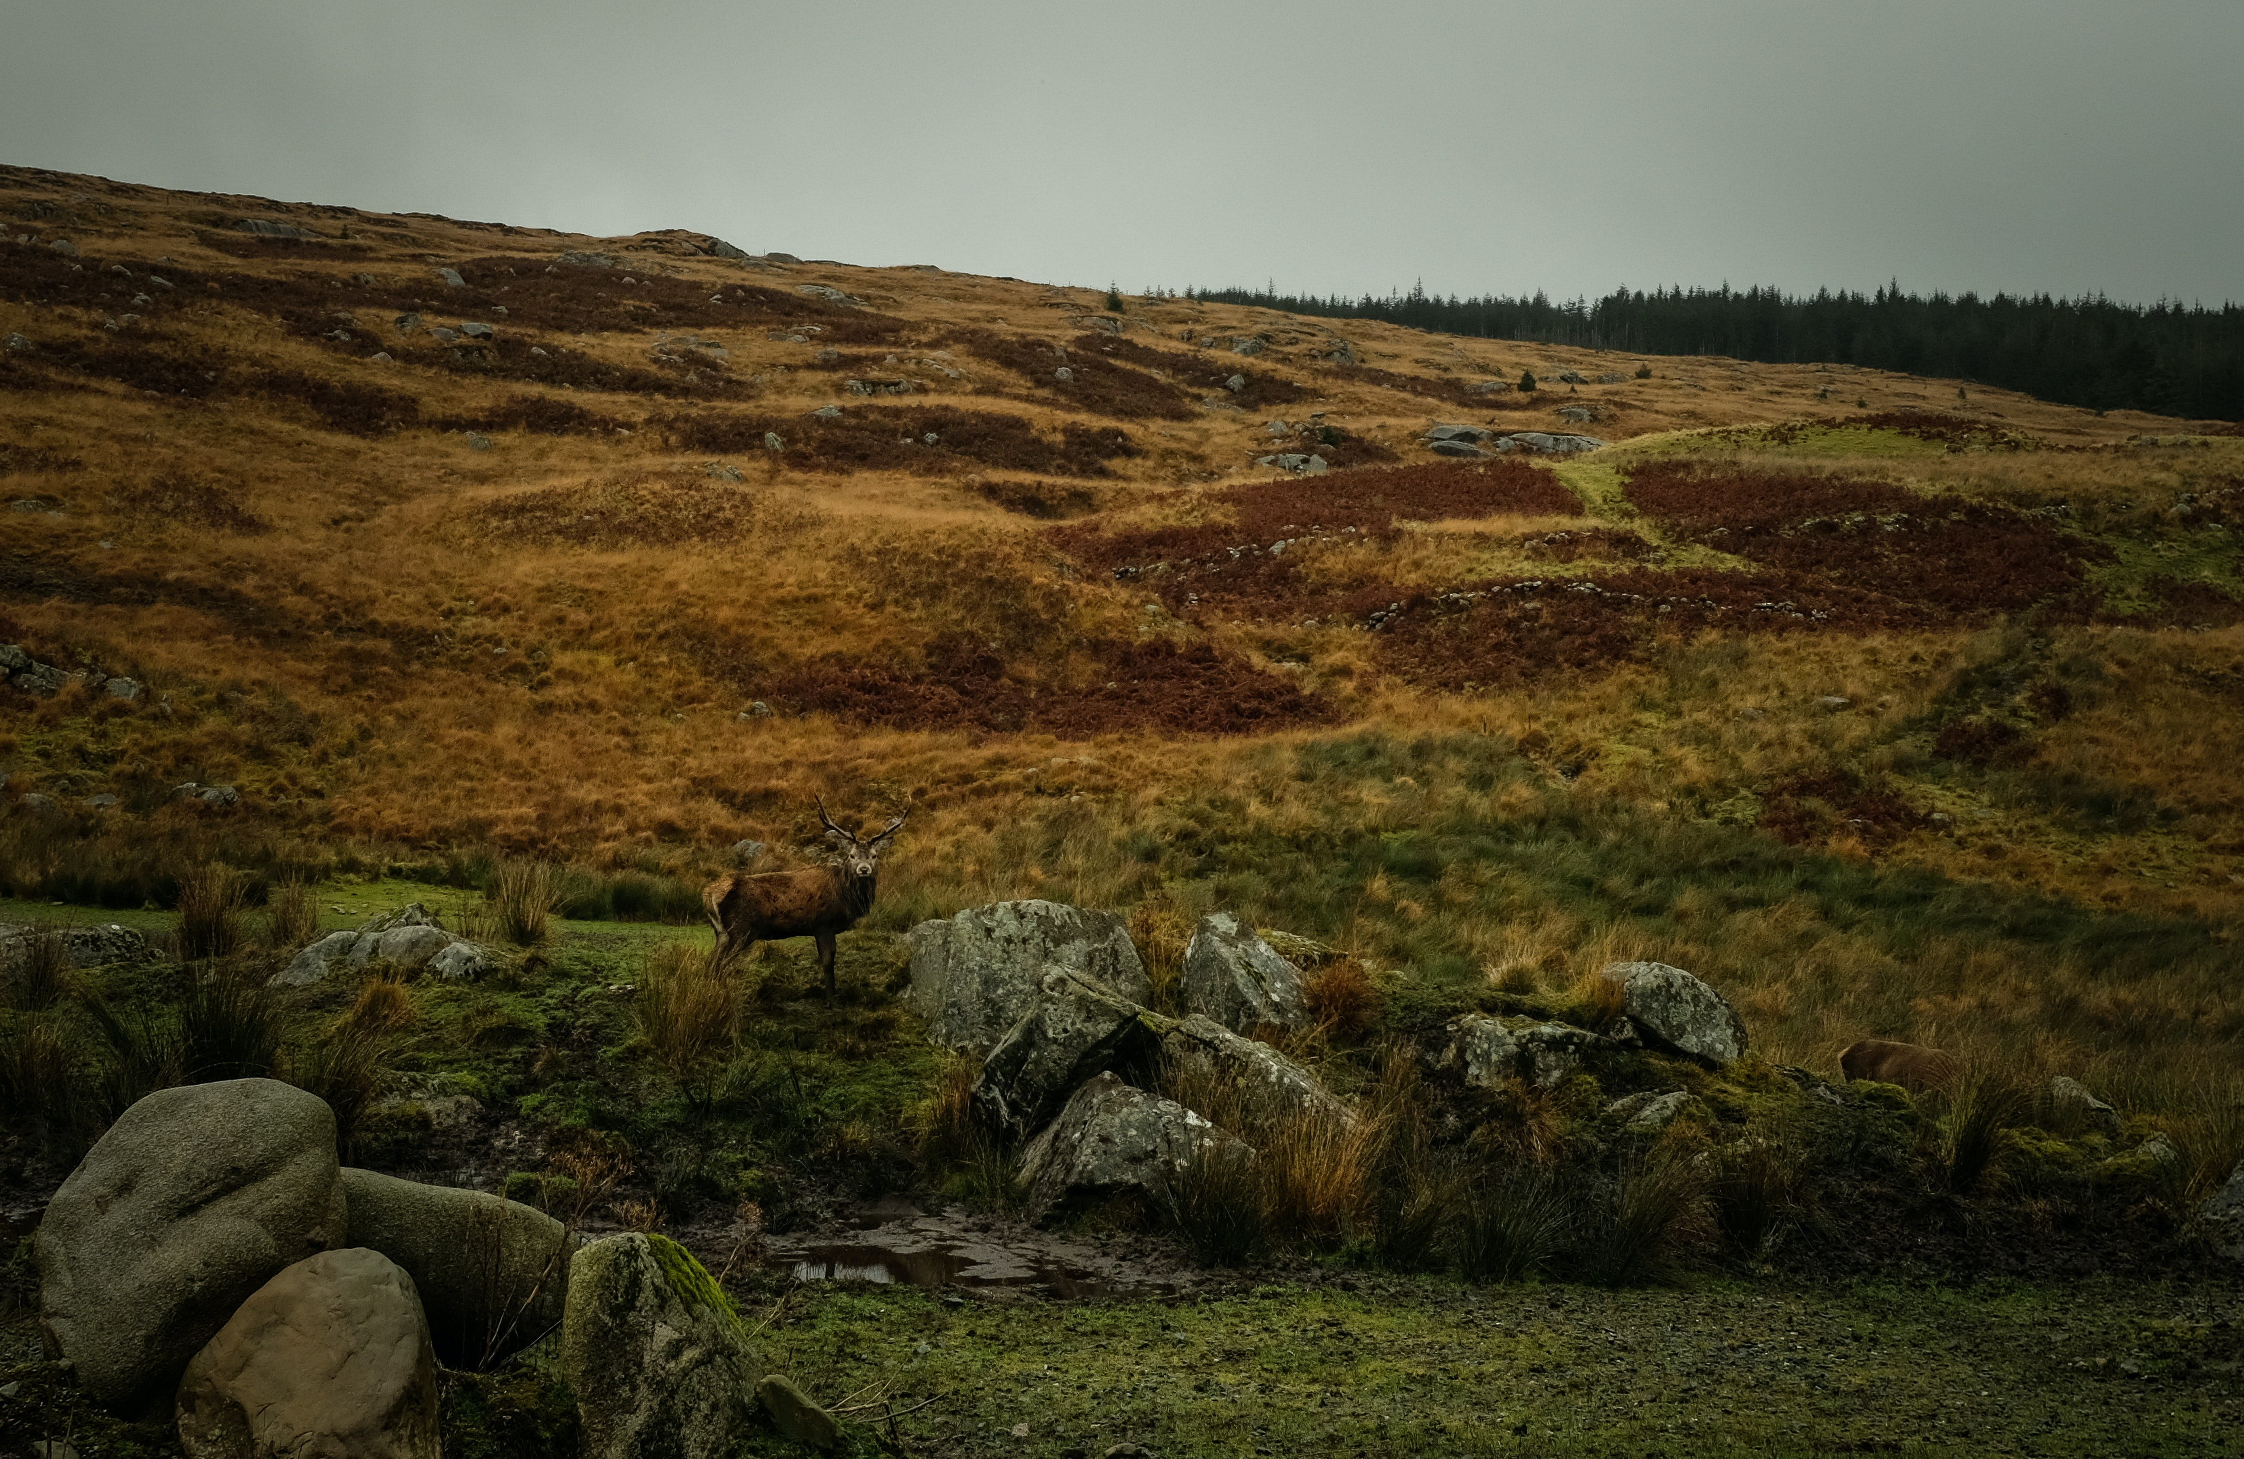
What is your favourite memory of your place?
Notes:
Start your presentation by asking the attendees to share their favourite memory of their place. This will help build the connection between what matters to people in the place

Slide 3
Past, present and future of climate change in Scotland

Slide 4
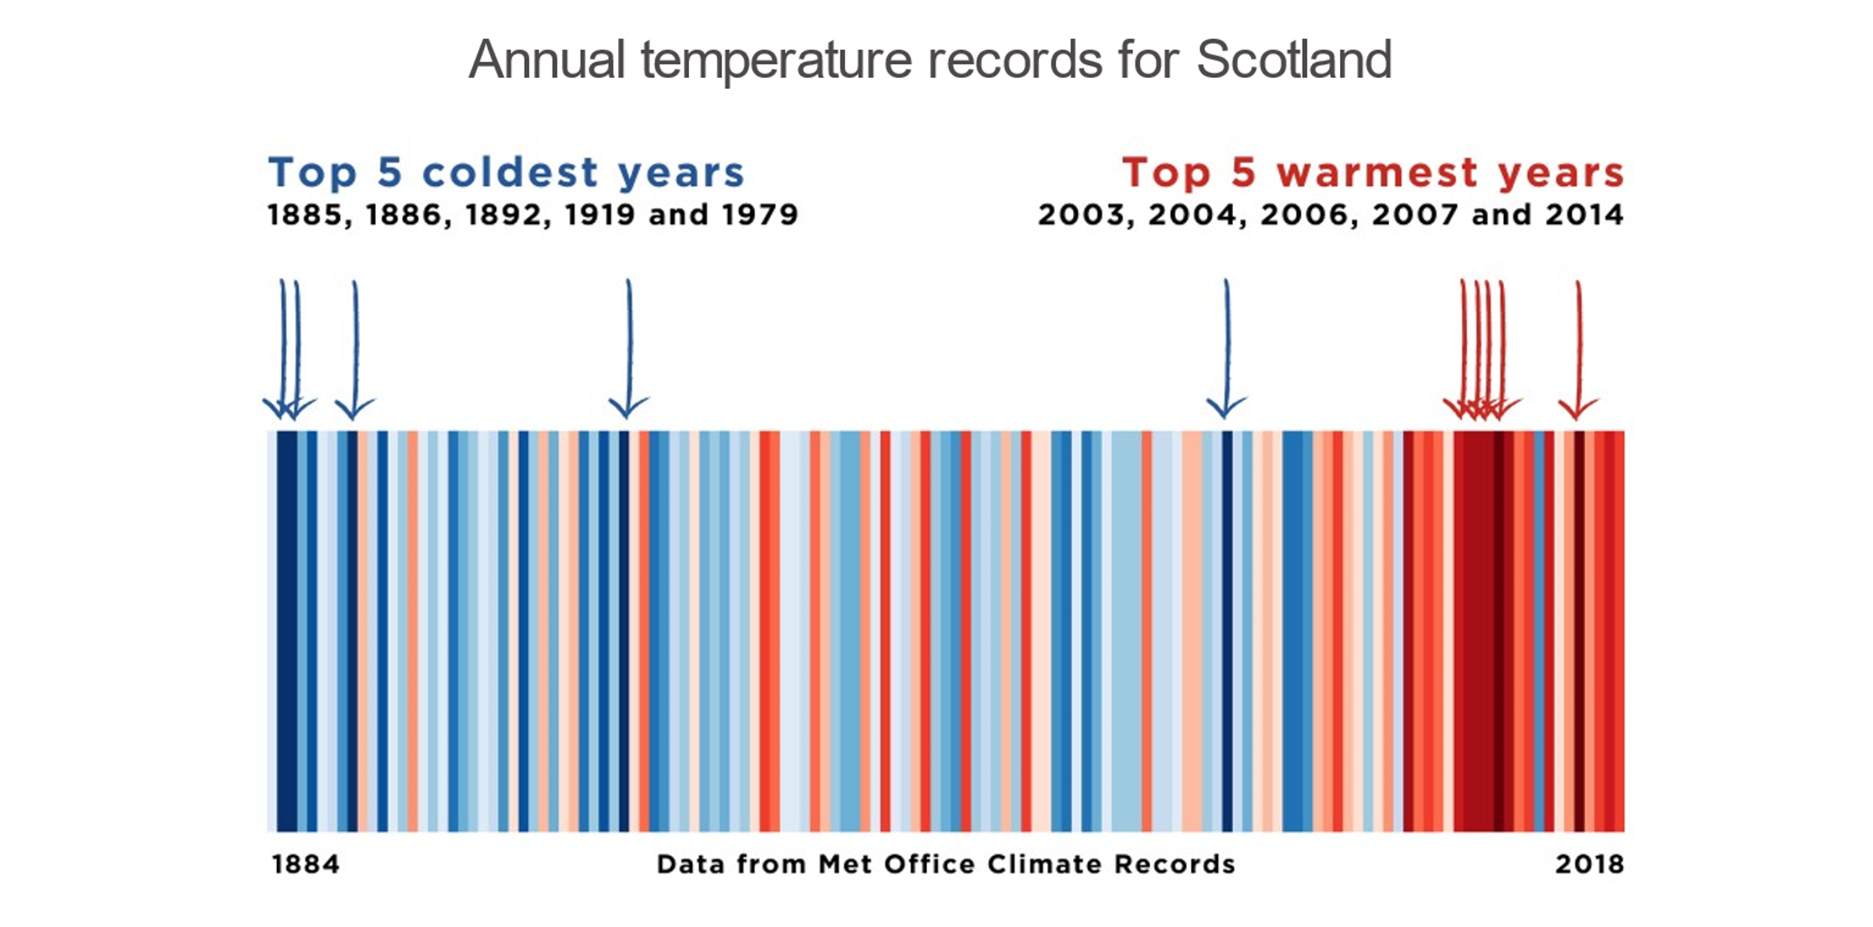
Scotland’s changing climate: recent past
Notes:
Illustration: climate stripes

Slide 5
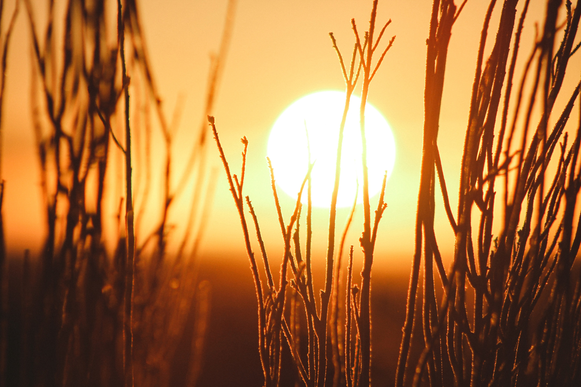
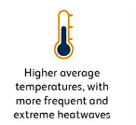
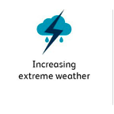
Scotland’s changing climate: recent past
Average temperature is increasing
The Science:
The last decade was 0.69 °C warmer than 1961 – 1990 average
Scotland’s 10 warmest years on record have all occurred since 1997
The warmest year on record was 2014
Changing weather:
Image credit: Jeremy Bishop on Unsplash
Notes:
Image credit: Jeremy Bishop on Unsplash

Slide 6
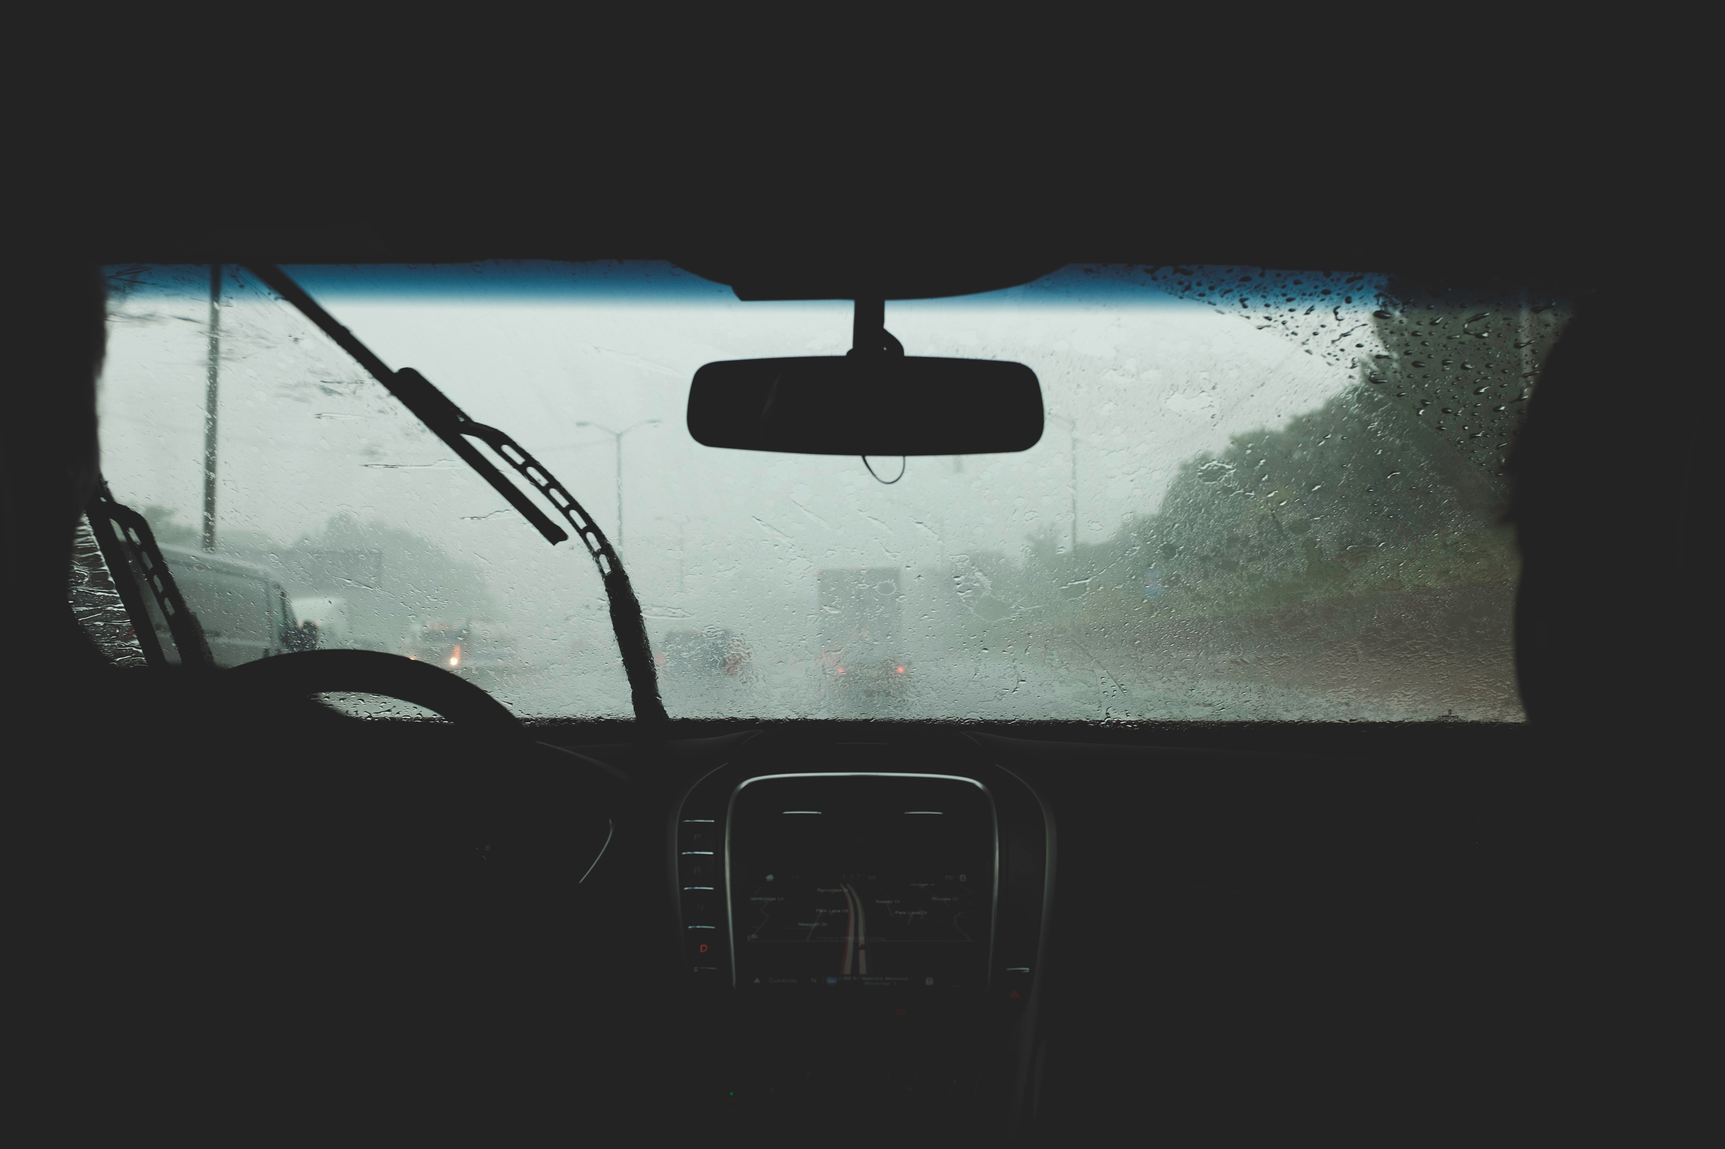
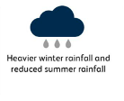
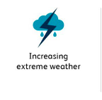
Scotland’s changing climate: recent past
Rainfall is increasing
The Science:
The last decade was 9% wetter than 1961 – 1990 average.
Biggest increases have occurred during winter - 19% wetter than 1961 – 1990 average
More heavy rainfall events
Changing weather:
Image credit: Charlie Deets on Unsplash
Notes:
Image credit: Charlie Deets on Unsplash

Slide 7
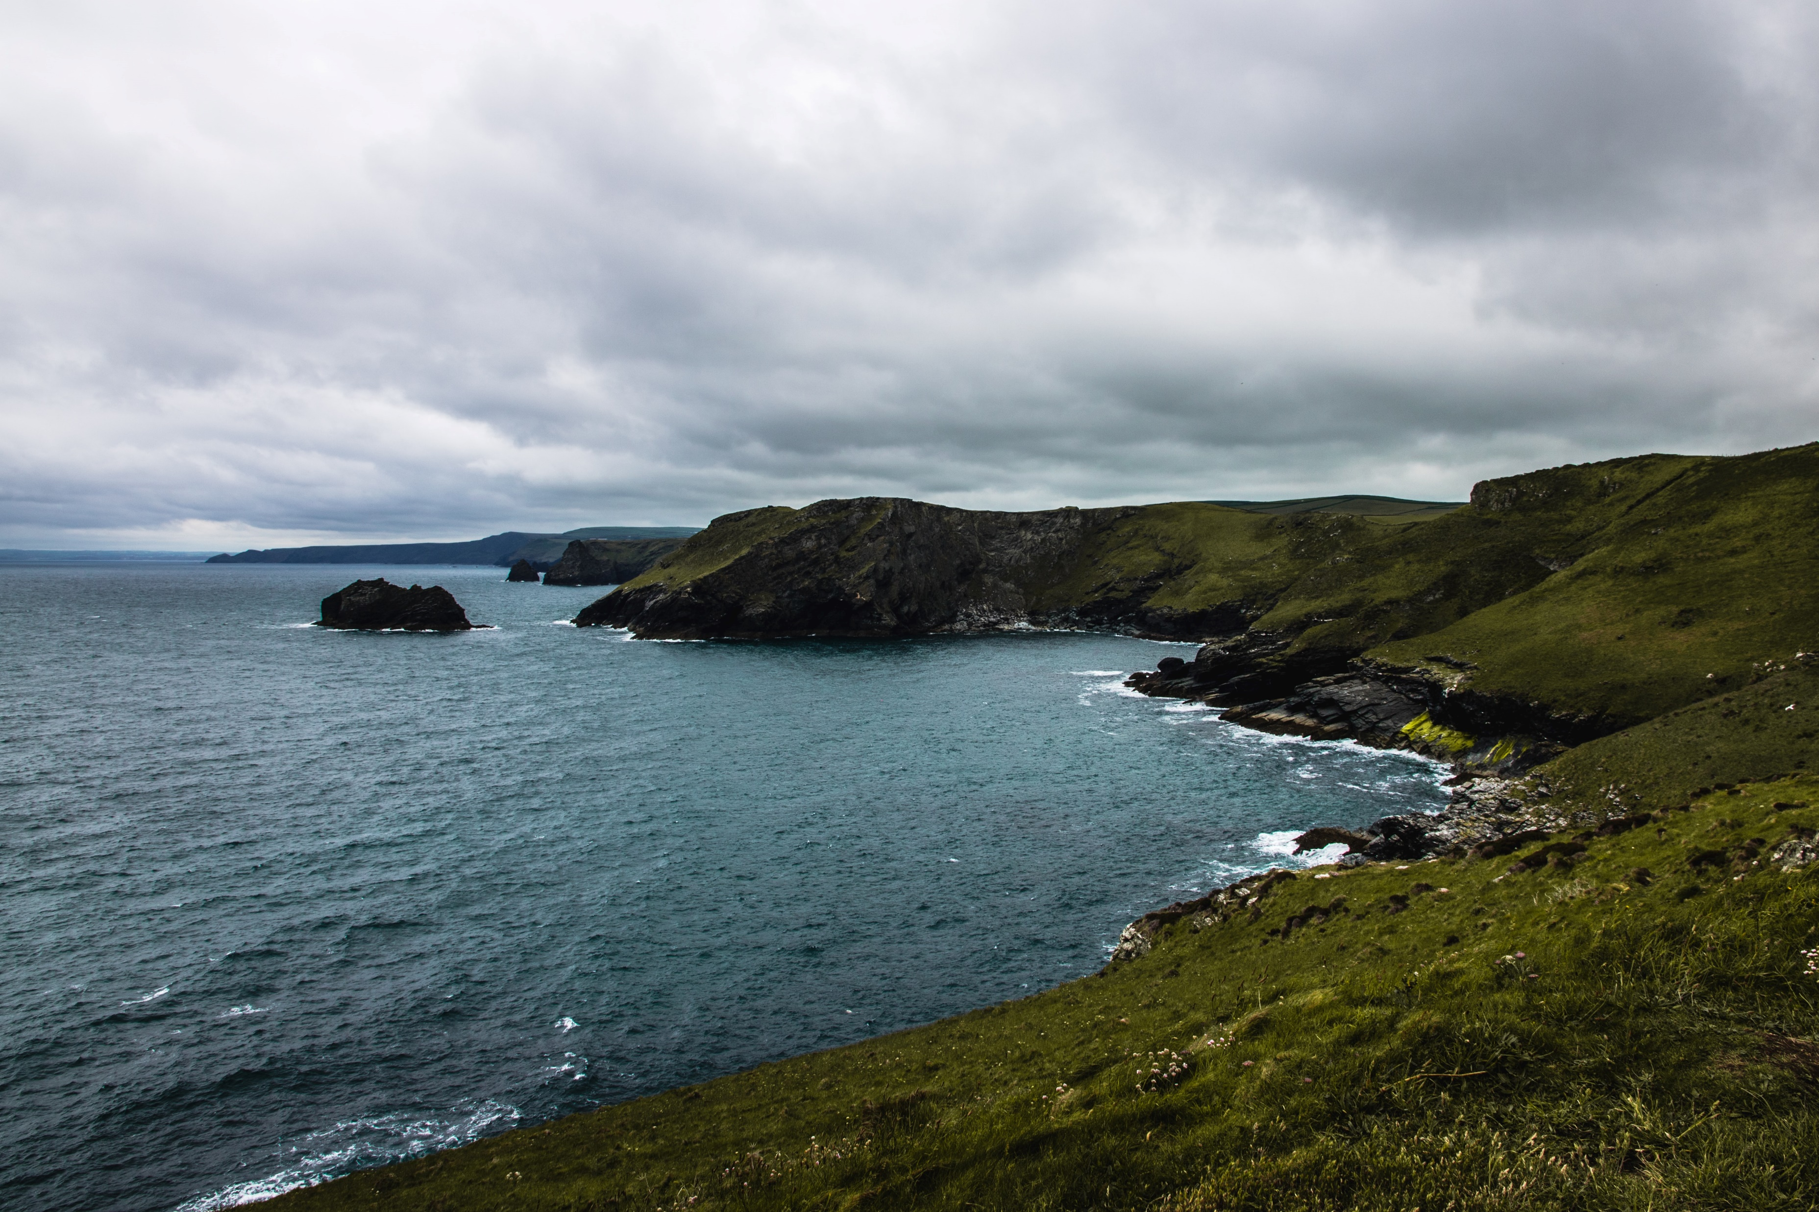

Scotland’s changing climate: recent past
Sea level is rising
The Science:
Mean sea level around the UK has risen by approx. 1.4mm per year since the start of the 20th Centenary.
Changing environment:
Image credit: Joachim Pressl on Unsplash
Notes:
Image credit: Joachim Pressl on Unsplash

Slide 8
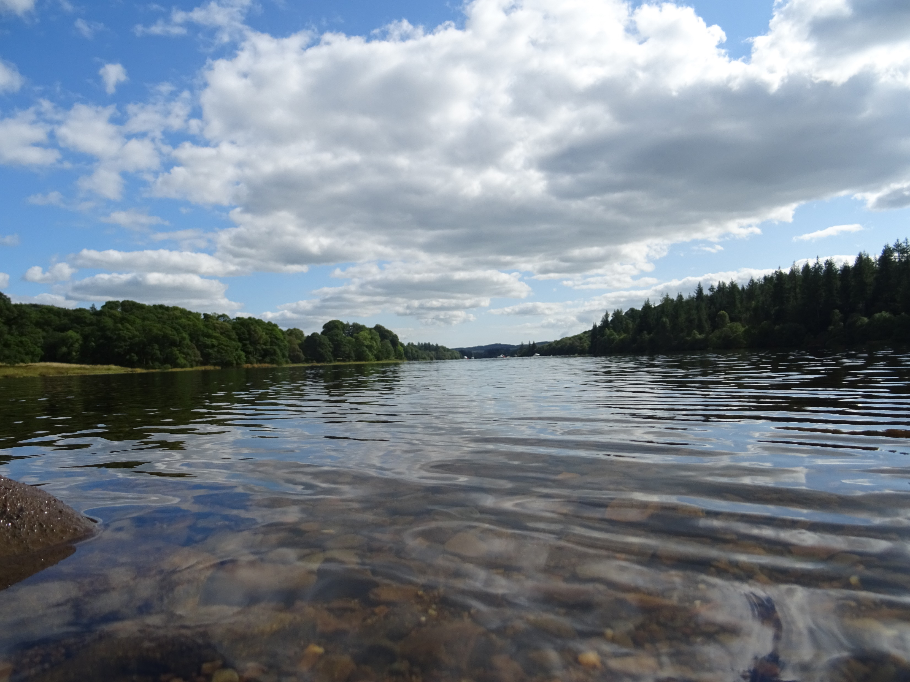
The changes in climate that we are already experiencing are projected to continue and intensify
Image credit Antoine Fabre on Unsplash
Notes:
Photo by Antoine Fabre on Unsplash

Slide 9
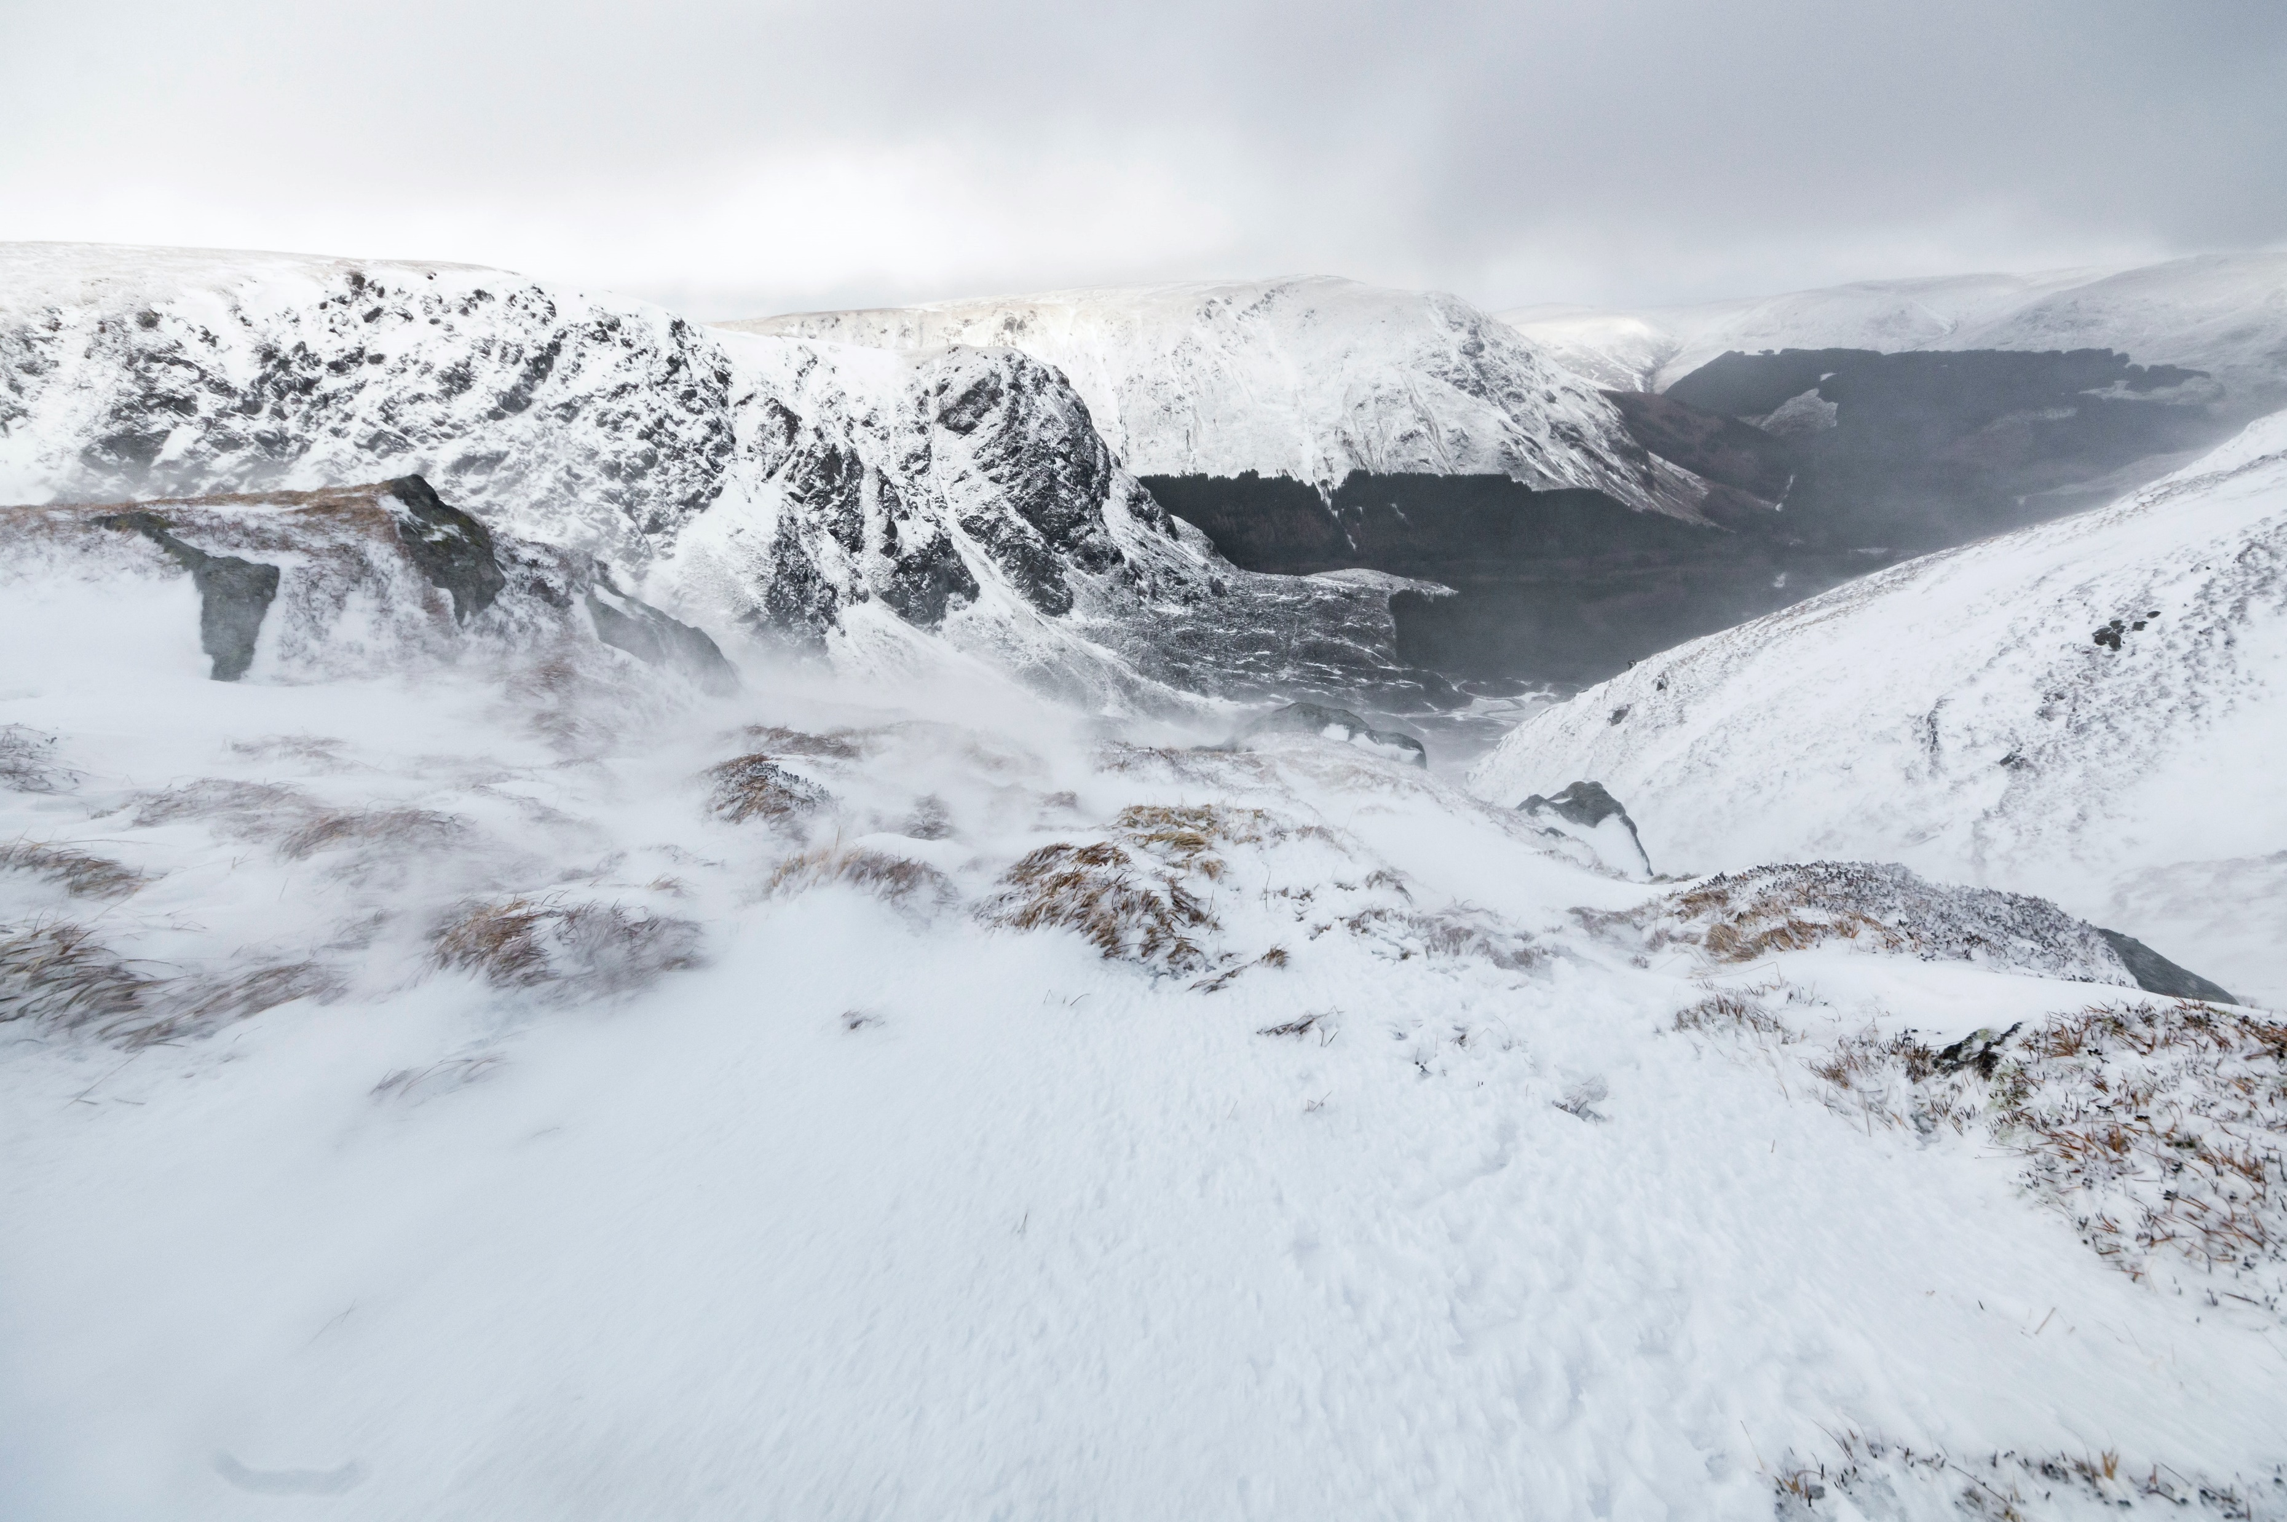
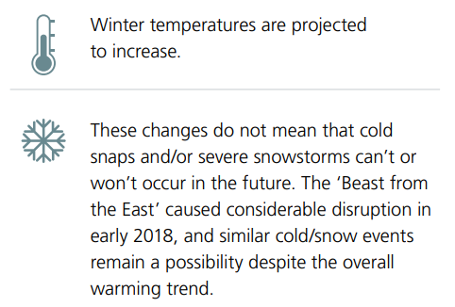
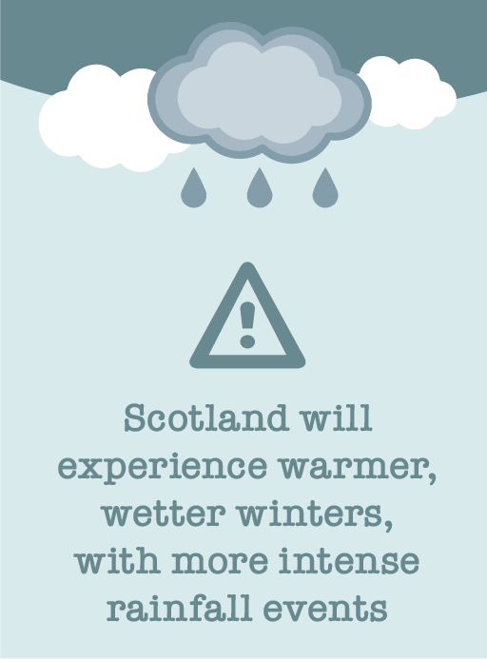
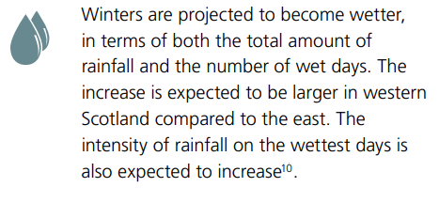
Key future trends: winter
Image credit Ben Jessop on Unsplash
Notes:
Photo by Ben Jessop on Unsplash

Slide 10
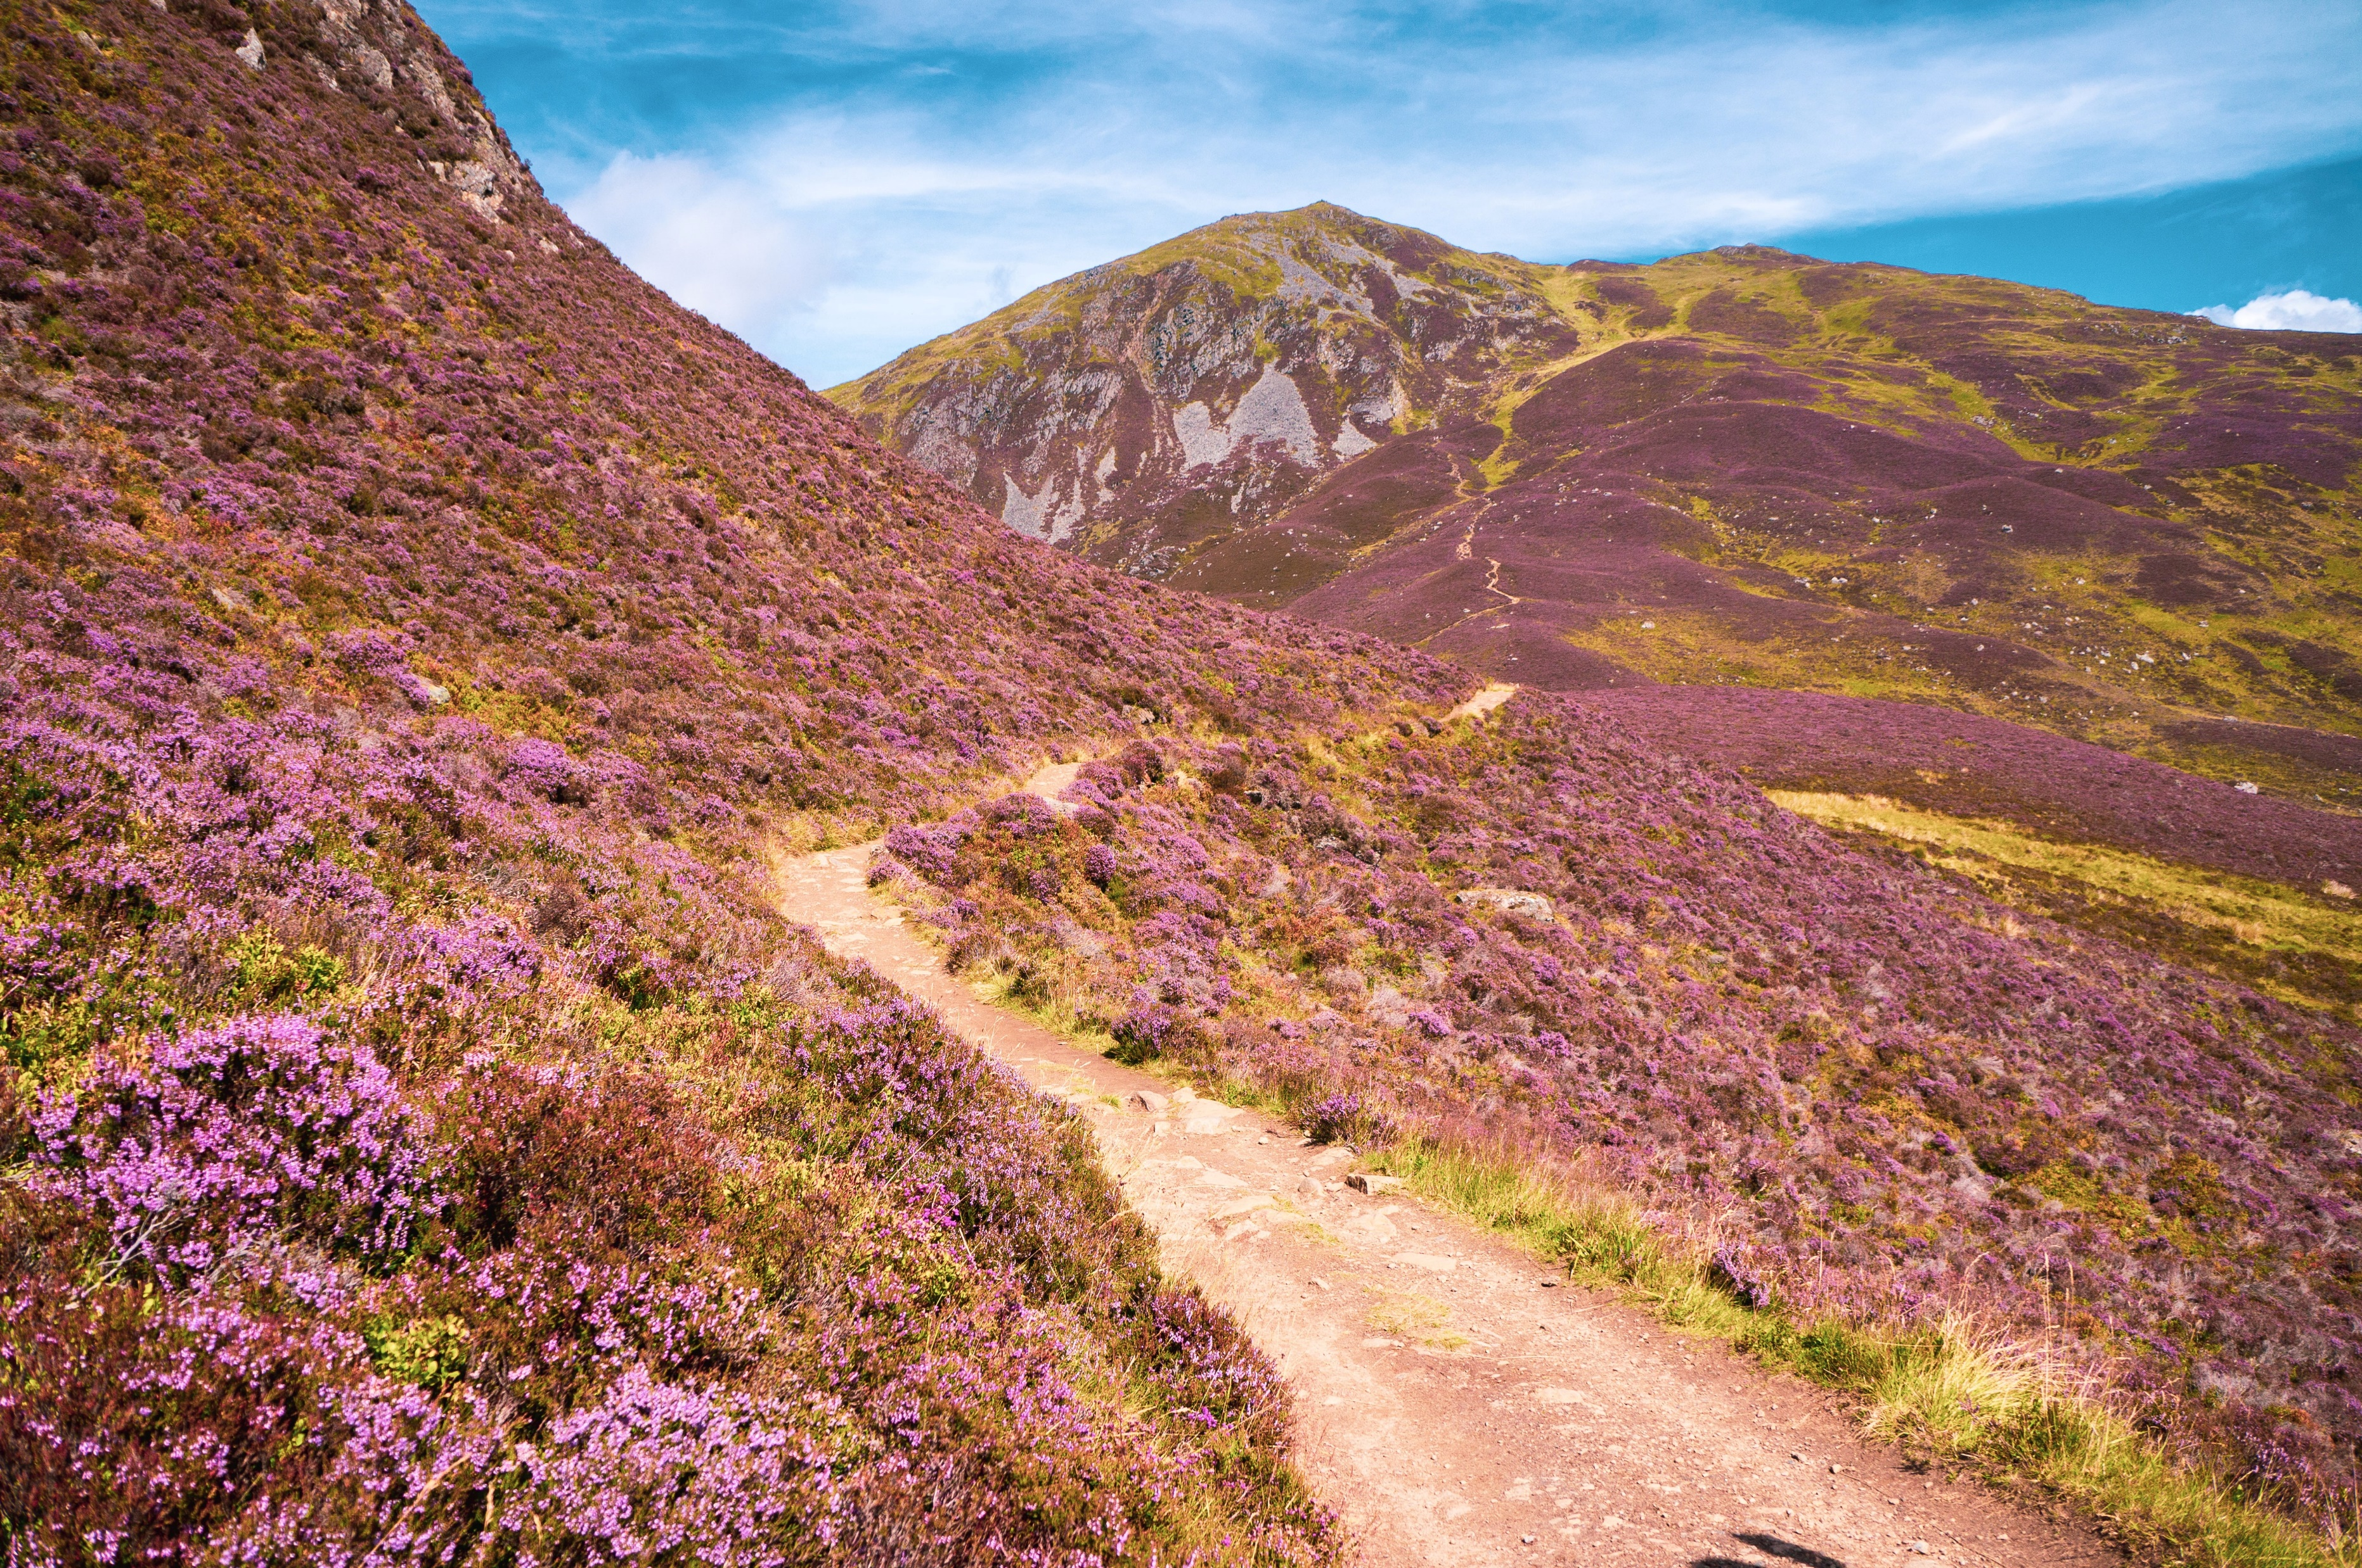
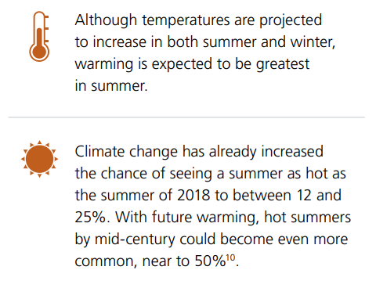
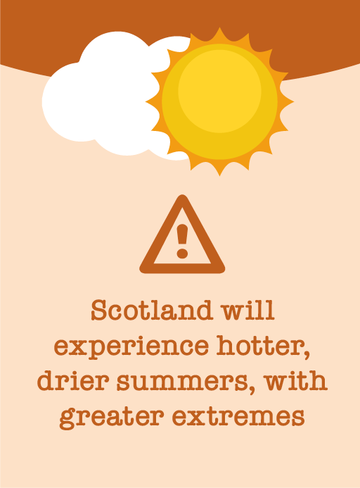
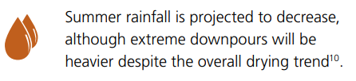
Key future trends: summer
Image credit: Eilis Garvey on Unsplash
Notes:
Photo by Eilis Garvey on Unsplash

Slide 11
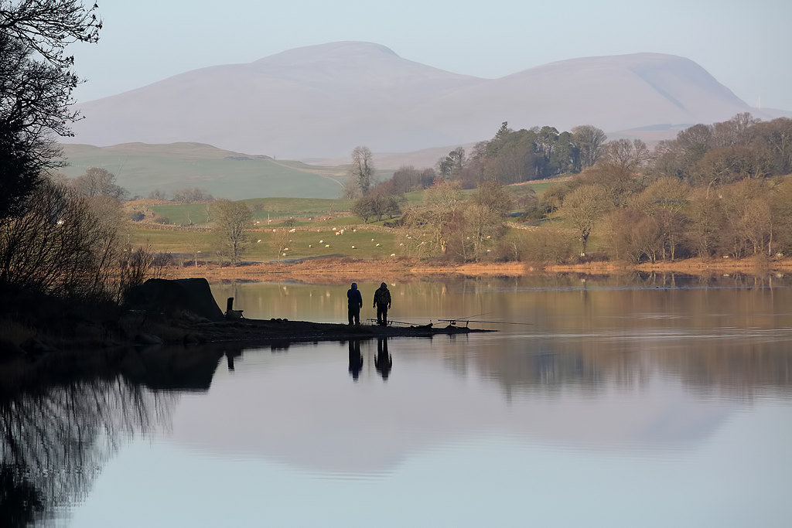
What climate / weather changes have you experienced while living in your area?
Image credit Walter Baxter
Notes:
Image credit: Walter Baxter

Slide 12
How might these changes affect Scotland?
Image credit Antoine Fabre on Unsplash
Notes:
Photo by Antoine Fabre on Unsplash

Slide 13
How will these changes affect Scotland?
The increased risk of flooding
The quality of our soils
The health and wellbeing of our people
The resilience of our businesses
Notes:
THE INCREASED RISK OF FLOODING
Flooding can already have a devastating effect on those affected. With climate change likely to alter rainfall patterns and bring more heavy downpours, we expect flood risk to increase in the future. This could impact on properties and infrastructure – with serious consequences for our people, heritage, businesses and communities.
THE QUALITY OF OUR SOILS
We rely on soils to sustain biodiversity, support agriculture and forestry, regulate the water cycle and store carbon. Soils also have an historic environment value, as a proxy record of environmental change and for the preservation of archaeological deposits and artefacts. Soils and vegetation may be altered by changes to rainfall patterns and increased temperatures - as well as the way we use the land.
THE HEALTH AND WELLBEING OF OUR PEOPLE
A warming climate may provide more opportunity to be outdoors and enjoy a healthy and active lifestyle, while reducing mortality in winter. However, it could affect patterns of disease and other health issues. Climate change and associated extreme weather may disrupt the lives of individuals and communities, limiting access to vital services and impacting on people’s physical and mental health.
THE RESILIENCE OF OUR BUSINESSES
Climate change and associated extreme weather may disrupt transport, energy and communication networks in Scotland and around the world. This could impact on markets, affect supply chains and raise insurance costs

Slide 14
How will these changes affect Scotland?
Infrastructure – network connectivity and interdependencies
The security and efficiency of our energy supply
Our cultural heritage and identity
The performance of our buildings
Notes:
THE SECURITY AND EFFICIENCY OF OUR ENERGY SUPPLY
Climate change may influence Scotland’s capacity to generate weather-dependent renewable energy. For example, varying water availability will affect hydro generation schemes. Climate change can also impact power distribution, with impacts ranging from damage caused by extreme weather events, to reduced transmission efficiency occurring as a result of temperature fluctuations. Impacts on global energy markets may also affect energy supplies in Scotland and consequently our overall energy security.
INFRASTRUCTURE – NETWORK CONNECTIVITY AND INTERDEPENDENCIES
Our energy, transport, water, and ICT networks support services are vital to our health and wellbeing and economic prosperity. The effect of climate change on these infrastructure systems will be varied. They are likely to be impacted by an increase in disruptive events such as flooding, landslides, drought, and heatwaves. Our infrastructure is closely inter-linked and failure in any area can lead to wider disruption across these networks.
OUR CULTURAL HERITAGE AND IDENTITY
The changing climate is already altering our unique Scottish landscape and threatening our historic environment through coastal erosion, flooding and wetter, warmer conditions. The increased pace of climate change presents challenges to all those involved in the care, protection and promotion of the historic environment.
THE PERFORMANCE OF OUR BUILDINGS
Climate change will have an impact on the design, construction, management and use of our buildings and surroundings. Whether retrofitting existing or building new, it is likely that there will be issues with water management (in flood and drought), weather resistance and overheating.

Slide 15
How will these changes affect Scotland?
The productivity of our agriculture and forests
The occurrence of pests and disease
The availability and quality of water
The health of our natural environment
Notes:
THE PRODUCTIVITY OF OUR AGRICULTURE AND FORESTS
A warming climate has the potential to improve growing conditions in Scotland and increase the productivity of our agriculture and forestry. However, climate change will also pose a number of threats, from more variable and extreme weather to the spread of pests and diseases, which may limit this potential.
THE OCCURRENCE OF PESTS AND DISEASE
As our climate changes, it will create new conditions that may allow existing pests and disease to spread and new threats to become established in Scotland. This may impact on the health of our people, animals, plants and ecosystems if risks are not properly managed.
THE AVAILABILITY AND QUALITY OF WATER
As our climate warms and rainfall patterns change, there may be increased competition for water between households, agriculture, industry and the needs of the natural environment. Summer droughts may become more frequent and more severe causing problems for water quality and supply.
THE HEALTH OF OUR NATURAL ENVIRONMENT
Climate change may affect the delicate balance of Scotland’s ecosystems and transform Scotland’s habitats and biodiversity, adding to existing pressures. Some distinctive Scottish species may struggle and could be lost, invasive non-native species may thrive, while a degraded environment may not be able to sustain productive land or water supply.

Slide 16
How will these changes affect Scotland?
The security of our food supply
The health of our marine environment
The change at our coast
Notes:
THE SECURITY OF OUR FOOD SUPPLY
Climate change may have an impact on global food production. Although Scotland may be able to grow more food, this will not offset the impact global disruption has on us. The effects of increased volatility in the global commodity market due to exposure to extreme climatic events has an impact on supply and cost of food
THE HEALTH OF OUR MARINE ENVIRONMENT
Our marine ecosystems – from plankton through to fish, mammals and seabirds – are already being affected by climate change alongside other pressures, particularly fishing. Changes will continue, with rising temperatures likely to change species and their distributions. The changes will present both threats and opportunities to our commercial fisheries and aquaculture.
THE CHANGE AT OUR COAST
Sea level rise is already having a widespread impact on parts of Scotland’s coast. With this set to accelerate over the coming decades, we can expect to see more coastal flooding, erosion and coastline retreat – with consequences for our coastal communities and supporting infrastructure.

Slide 17
Which of these (or others) impacts of climate change have you experienced in your area?
Image credit Walter Baxter
Notes:
Image credit: Walter Baxter

Slide 18
How do we respond?
Image credit Antoine Fabre on Unsplash
Notes:
Photo by Antoine Fabre on Unsplash

Slide 19
How do we respond?
Mitigation
Reducing and preventing getting greenhouse gases out into the atmosphere
Includes: phasing out fossil fuels, reduction of emissions, energy efficiency measures, renewable energy generation, non-fossil fuels alternatives for living and moving around

Slide 20
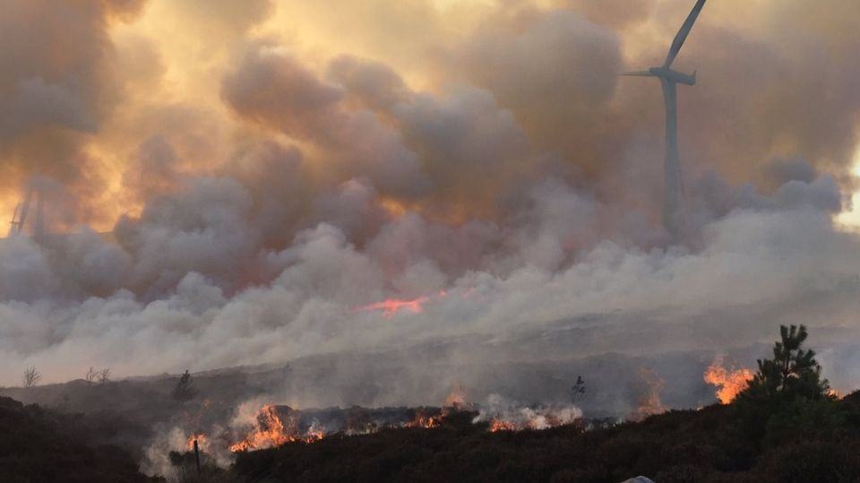
Even if we were to reduce our emissions overnight – climate changes set in motion in the past couple of hundred years will still be occurring
Notes:
Photo by Antoine Fabre on Unsplash

Slide 21
How do we respond?
Adaptation
a response to the climate changes we’ve seen in our climate over the past few decades
not just reacting to them when they happen, but actually changing how we live & work to be less vulnerable (and living better lives in general)
preparing for the challenges that we will face as our climate continues to change

Slide 22
How can we adapt?
Image credit Antoine Fabre on Unsplash
Notes:
Photo by Antoine Fabre on Unsplash

Slide 23
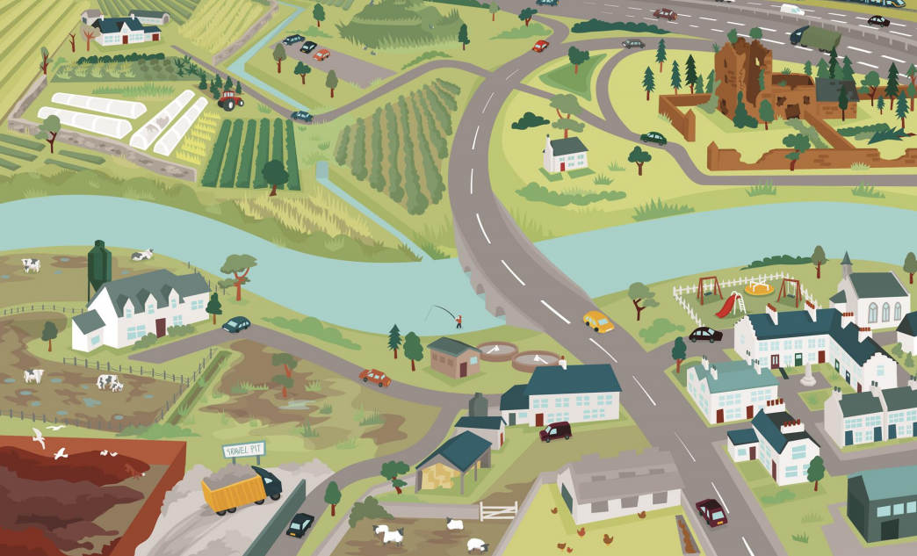
Unadapted place
Vulnerable historical / touristic sites
Heavy flooding
In the catchment
Unprotected infrastructure ,
Play & recreation areas
Waterlogged ground &
cattle struggling with heat
Drying out of the
lowland raised bog
Localized surface
water flooding
Notes:
To use as an example
For more information and examples of what adaptation looks like for specific regions in Scotland see Climate Ready Places

Slide 24
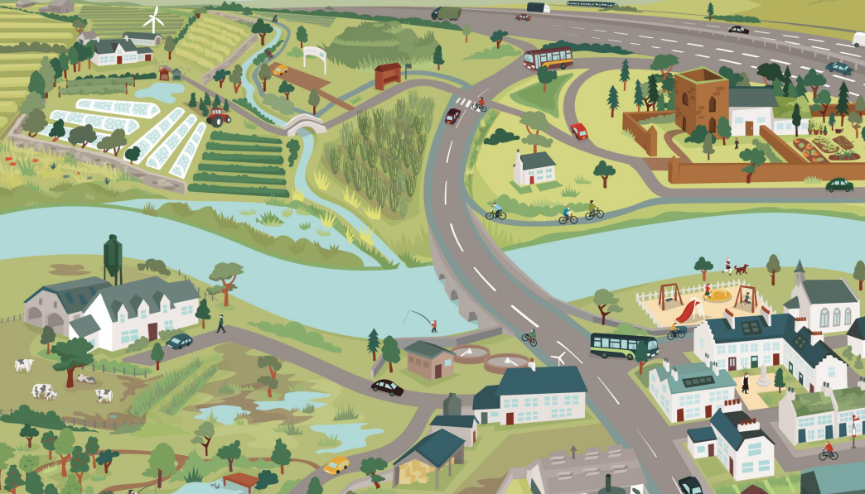
Adapting place
Adjusting the kinds
of crops grown
Ensuring active
travel routes
Re-naturalizing
water courses
Protecting and
repurposing
heritage sites
Reconnecting the river
with its floodplain
Individuals knowing what to do in case of flooding / forest fires
Improving livestock buildings
Climate ready homes
Creating upstream storage
for flood waters
Restoring bogs
Community knows
who and what is vulnerable
Active local flood resilience groups
Notes:
To use as an example
For more information and examples of what adaptation looks like for specific regions in Scotland see Climate Ready Places

Slide 25
What might adaptation mean for your place?
Image credit Walter Baxter
Notes:
Image credit: Walter Baxter

